Slide 1
SCM 651: Business Analytics
Final Exam Review

Slide 2
Final Exam
Academic integrity
Do your own work, no collaboration
My philosophy
More questions, each worth fewer points
Advantage: if you don’t know the answer on a question, it’s only worth a few points
Test breadth of knowledge (multiple choice)
Test depth of knowledge (short answer)
Test Taking Strategy
Strive for full credit on a question – there is no extra credit for elaborate answers, so don’t spend too much time on any question
Use your time wisely
You will not run any other software – just answer the questions

Slide 3
Final Exam
62 Questions
Each question worth 1 or 2 points
Multiple Choice - 55 Questions
Short Answer – 7 Questions

Slide 4
Final Exam
Content
Part 1: Tools – Multiple Choice (10 Q 1 point each)
Identify which tool was used in a given example (e.g., Excel, Access, Google Analytics, R, Tableau)
Part 2: Modelling Techniques – Multiple Choice (6 Q 1 point each)
Identify which technique is presented in example (e.g., correlation, linear regression, exponential regression, power regression, moving average, logit, probit, neural network)
Part 3: Optimization techniques – Multiple Choice (2 Q 1 point each)
Identify which optimization technique will find the solution in the shortest amount of time (fastest): simplex, GRG nonlinear, GRG nonlinear with multi-start, evolutionary?
Part 4: Regression Assumptions – Multiple Choice (6Q 1 point each)
Identify assumption violations, solutions (linearity, multi-collinearity, heteroscedasticity, serial correlation, outliers)
Identify the solution to a violation of the regression assumption
Box-Cox and Box-Tidwell transformations
Part 5: Interpretation – Multiple Choice (21Q 2 points each)
Interpret output results of a technique
Part 6a: Concepts – Multiple Choice (10 Q 2 points each)
Identify a concept or business application
Part 6b: Concepts – Short answers(7 Q 2 points each)
Define or describe a concept or business application

Slide 5
Week 1 - Excel
Primary material
Lookup
Sorting and filters
Pivot tables and charts
3D Maps
Supplemental material
Navigation (naming ranges)
Calculations, formulas, auditing
Sparklines and conditional formatting
Graphing and visualization
Tables
Math and text operators
Index and match

Slide 6
Week 2 - Excel
Excel
Descriptive Statistics
Correlation
Linear regression
Exponential regression
Power regression
Time series & moving average
Forecasting
Multivariate regression
Prediction, sensitivity analysis, conditional formatting
Categorical variables and dummy variables
Scenario Manager (supplemental material)

Slide 7
Week 3 – Google Analytics
Google Analytics: general measures
Sessions: number of times the site was visited (does not count pages)
Users: number of unique users identified by IP addresses
Pageviews: number of individual web pages viewed
Pages/Session: average number of pages viewed in a session
Avg. Session Duration: time spent on website before leaving
Bounce Rate: percentage of visitors who do not visit a second page
% New Sessions: percentage of sessions with new users

Slide 8
Week 3 – Google Analytics
Google analytics: audience
New vs. returning
Frequency and recency
Engagement (length of time on site)
Benchmarking: comparing your website to industry average
Google Analytics: Acquisition
Channels (organic search, direct, referral, social, email)

Slide 9
Week 4 - Access
Access
Importing data into Access
Excel spreadsheets, text files, XML, et al.
Relationships can be created
Between common fields in two tables
Grouping
Collapses together rows of data according to the field grouped
Criteria
Identifies a subset of data (filter)
Calculations
min, max, sum, average, standard deviation, variance, count
Dirty data
To identify inconsistent key fields used to match two tables, use both a left and right join

Slide 10
Week 4 - SQL
SQL commands for Queries
SELECT identify fields to be reported
AS creates an alias for reporting labels
FROM identify tables to be used
WHERE filter criteria
GROUP BY clustering criteria
HAVING criteria based on a calculation
ORDER BY sorting criteria
IN part of a list
BETWEEN range of numbers
IS NULL empty values
LIKE matches string of characters

Slide 11
Week 5 – Power Pivot & Power Query
Power Pivot and Power Query
Pivot tables summarize data in one spreadsheet.
Power Pivot and Power Query allow external databases, spreadsheets, websites, and other sources to be imported and generate pivot tables using multiple sources simultaneously.
Power Query connects to data and uses Power Pivot for analysis.
Power Pivot can connect to certain data and generate PivotTables and PivotCharts.
Power Pivot is built into Excel and requires an installation.

Slide 12
Week 5 – Slicers and Timelines
Slicers
A Power Pivot slicer is a user-friendly menu for categorical data.
Timelines
A Power Pivot timeline is a user-friendly menu for date ranges.

Slide 13
Week 6 – Goal Seek
Goal Seek
Limited to one input
Limited to finding the value of the input which results in an output equal to a specific value
Goal Seek cannot have any constraints

Slide 14
Week 6 - Solver
Solver
Solver can find input values that result in a minimum output value, maximum output value, or an output equal to a specified value (break-even point: profit = 0)
Solver can change up to 200 input variables
Solver can have up to 100 constraints
Constraints can include inequalities (less than or equal to, greater than or equal to), binary (yes/no), and integer (whole numbers)

Slide 15
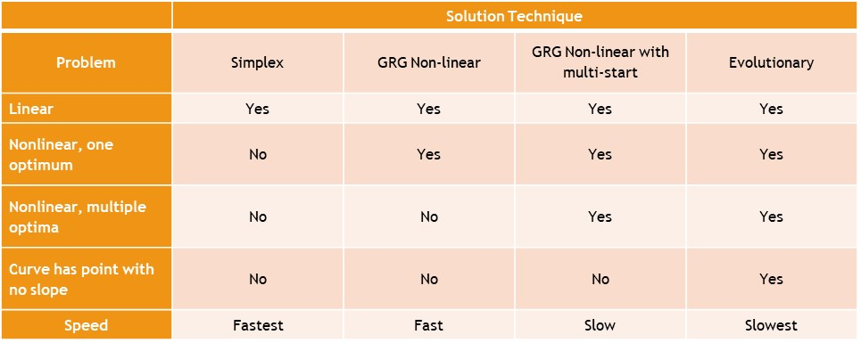
Week 6 – Solver techniques

Slide 16
Week 7 – R Basics
R: 3D visualization
Histograms
Boxplots (box and whisker)
Scatterplots
Scatterplot matrix
Plot of means
XY plots
3D graphs
Descriptive statistics
Correlation
ANOVA
Dummy variables (be able to interpret from regression)
Moderating effects (be able to interpret from regression)

Slide 17
Week 8 – Choice models
Logit & Probit
Dependent variable is binary (0,1)
Predict probabilities
S-shaped curve (Always increasing or always decreasing)
Logit
Logistic distribution
More sensitive at extreme values of X variables
Probit
Normal distribution
More sensitive at values of variables near their means

Slide 18
Week 8 – Neural Networks
Neural networks can have:
Multiple inputs
One or more hidden layers
Two or more hidden layers are called deep learning
One or more outputs
Outputs can be binary (0-1) or continuous

Slide 19
Week 9 – Regression Assumptions
Violations
Nonlinearity
Multicollinearity
Heteroscedasticity
Serial correlation
Outliers
Correction
Box-Cox, Box-Tidwell
Factor analysis
Huber regression
Prais-Winsten
Drop outlier

Slide 20
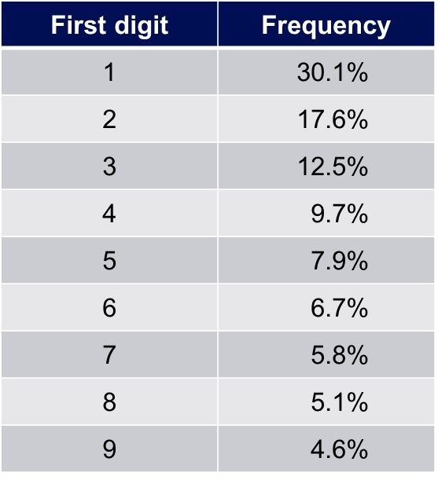
Week 9 – Benford’s Law
Benford’s law states that financial numbers tend to start with smaller digits.
Deviations from this distribution are often a signal of fraud.
Benford’s law can detect fraud in expense reports, accounts receivable, accounts payable, financial statements, and income tax returns.

Slide 21
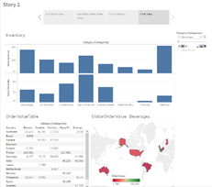
Week 10 - Tableau
Tableau can:
Import data from a variety of file types
Create pivot tables
Generate a variety of graph types
Build worksheets, dashboards, and stories

Slide 22
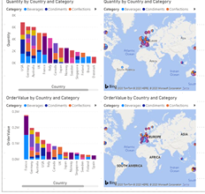
Week 10 - Tableau
MS Power BI can:
Import data from a variety of file types
Create pivot tables
Generate a variety of graph types
Build worksheets & dashboards

